Slide 1
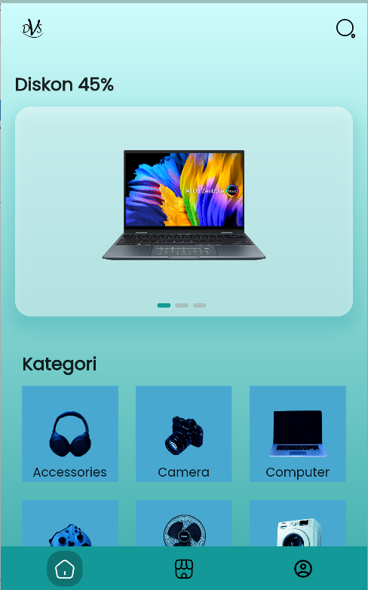
https://github.com/angelodellamorte404/deus_vult_shop-flutter

Slide 2
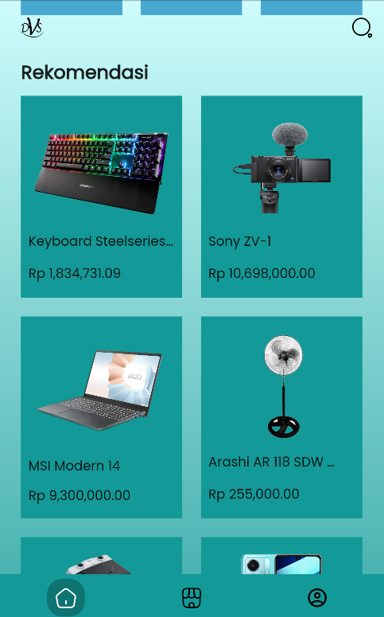
https://github.com/angelodellamorte404/deus_vult_shop-flutter

